Slide 1
Applied Data Science Machine Learning in Python
Dr. Omri Allouche
2017

Slide 2
Recommended Reading
Read https://www.analyticsvidhya.com/blog/2015/09/naive-bayes-explained/
or http://guidetodatamining.com/assets/guideChapters/DataMining-ch6.pdf (longer)

Slide 3
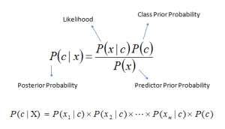
Bayes Formula

Slide 4
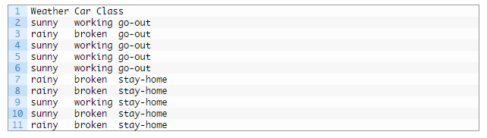
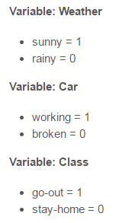
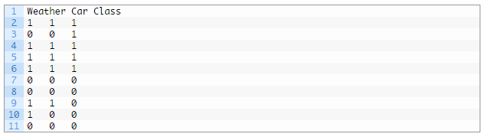

Naïve Bayes - Example

Slide 5
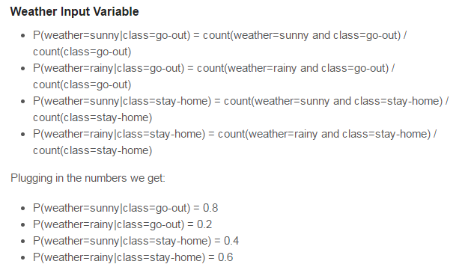

Slide 6
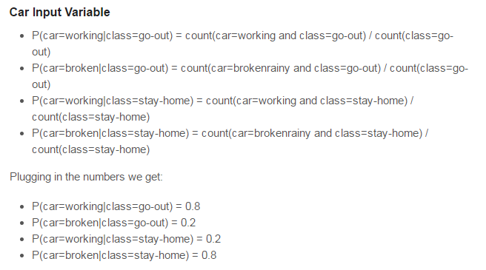

Slide 7
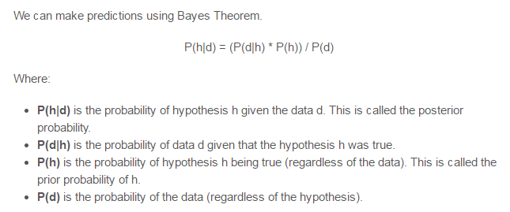
Using Bayes Theorem

Slide 8
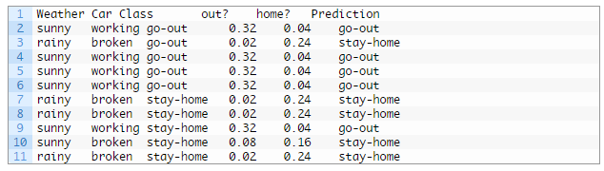
Making Predictions

Slide 9
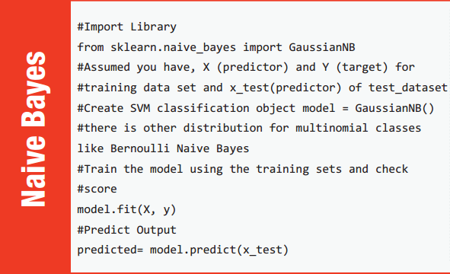

Slide 10
Numeric FEATURES - Distributions
Gaussian
Used in classification. Assumes that features follow a normal distribution
Multinomial
Used for discrete counts (e.g. word occurrences in document)
Bernoulli
Treats feature as binary (e.g. word appears or not in document)
Exponential
Your own

Slide 11
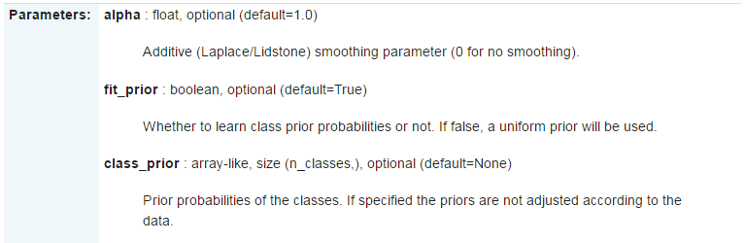
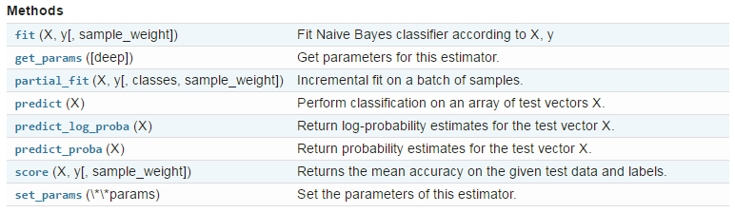

Slide 12
Properties
Very fast
Good for big data with big velocity
Small dataset leads to instability (probabilities can be 0 or 1 with high variance)
Ignores interactions and therefore needs less data
Works well with multiclass problems
Works well with missing data
Continuous features require binning or assumption of a distribution
Doesn’t perform well for imbalanced datasets
Can be used for segments of the data (with other models for the rest)
Can be used as a generative model (e.g. generate text)

Slide 13

Issues
Works better for categorical features. For numerical features, assumes a distribution (often Gaussian distribution)
Instead of multiplication of probabilities, use sum of logs to avoid underflow
Performance degrade with highly correlated features
“Zero frequency” - how to handle values with 0 occurrences?
Often: Use Laplace correction
Known to be a good classifier, bad estimator

Slide 14
Application – Language Model
How likely is each sentence in the language?

